Slide 1
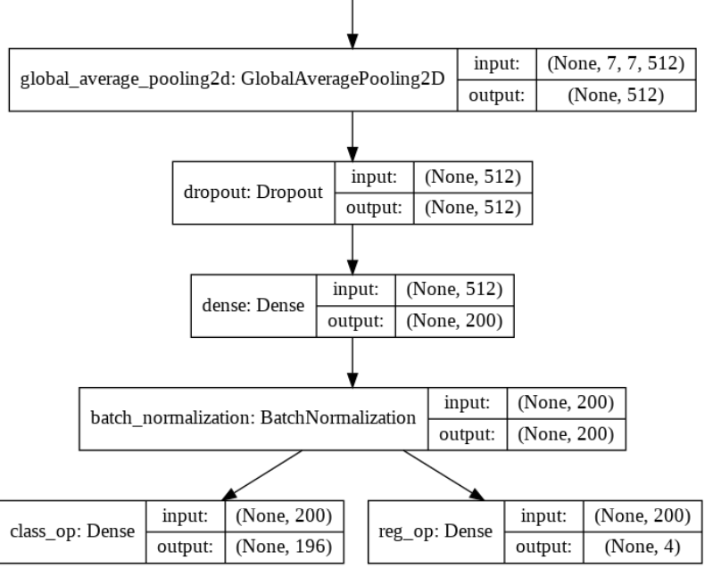
VGG16
Model - Key Details:
Used Transfer Learning Approach
VGG16 is the Back bone architecture
Input Image size is 224*224*3
Used ‘Imagenet’ weights
Image Augmentation not done
Optimizer = Adam
Loss for box co-oridinates =‘mse’
Loss for Classification = ‘categorical_crossentropy’
Metric for box co-oridinates =‘IoU’
Metric for box Classification =‘Accuracy’
Trainable params: 143,200
Non-trainable params: 14,715,088
Training & Validation Accuracy for Classification = 0.11 & 0.001
Training & Validation IoU for Bounding Boxes = 0.004 & 0.004
Model Architecture:
Pretrained VGG16 Model Excluding Top Layer
Additional References:
Data Preparation steps for Modeling
Defining Batch Generator function
Defining IoU calculation function
Future Plan for Model Optimization

Slide 2
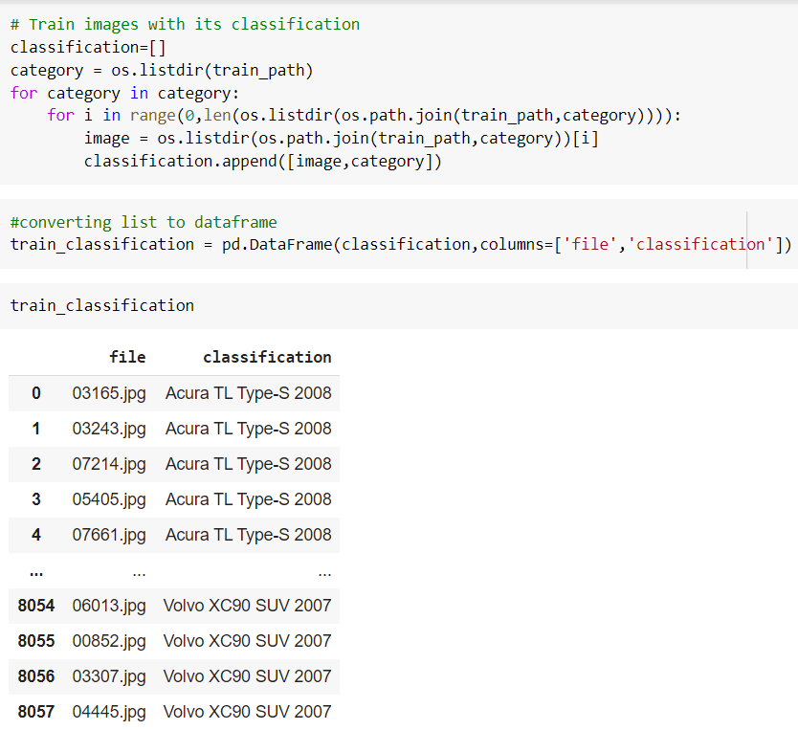
Data Preparation for Modelling
Mapping of Images in train folder with it class and storing in a dataframe

Slide 3
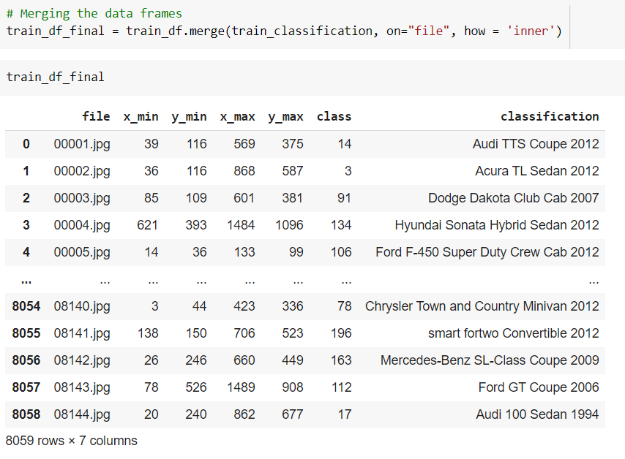
Data Preparation for Modelling
Train Images with the classification are merged with respective the bounding box Co-ordinates

Slide 4
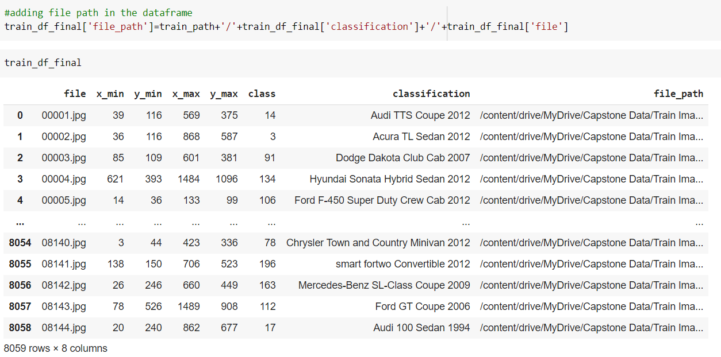
Data Preparation for Modelling
File path has been added against each training images , so that we can create the pipeline to access the images at ease

Slide 5
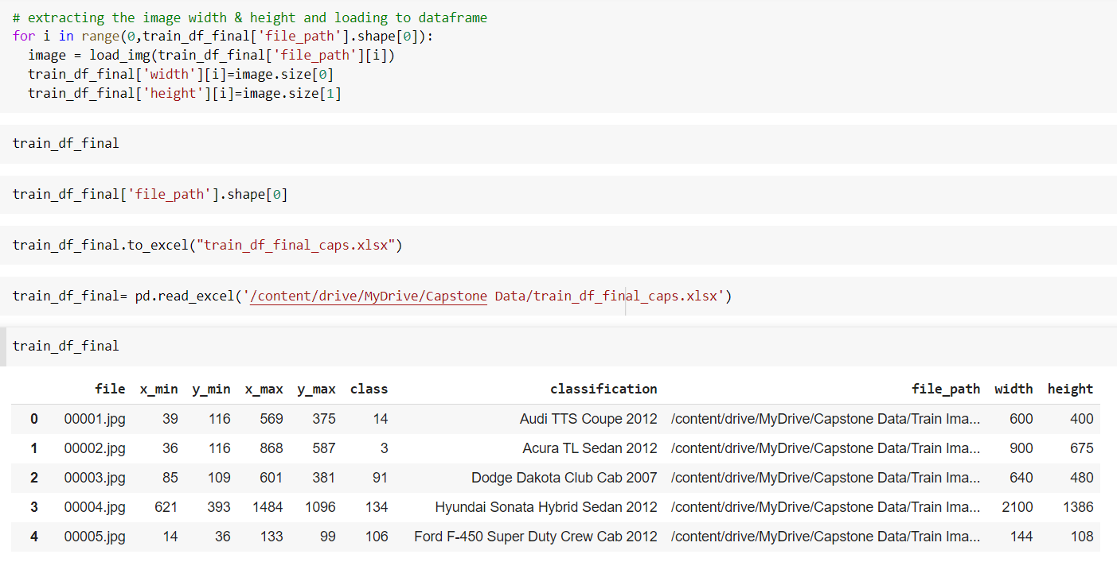
Data Preparation for Modelling
Image width and height is mapped against the following function , it will be required when we have to modify the bounding box coordinates based on the resized images

Slide 6
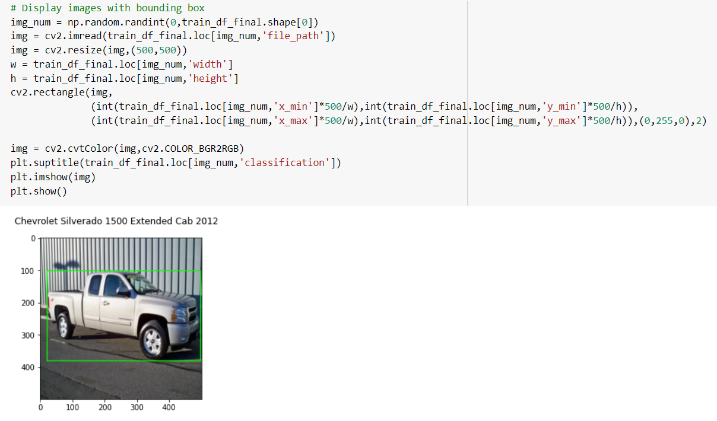
Data Preparation for Modelling
Cv2 library is used to display the random images with it bounding boxes

Slide 7
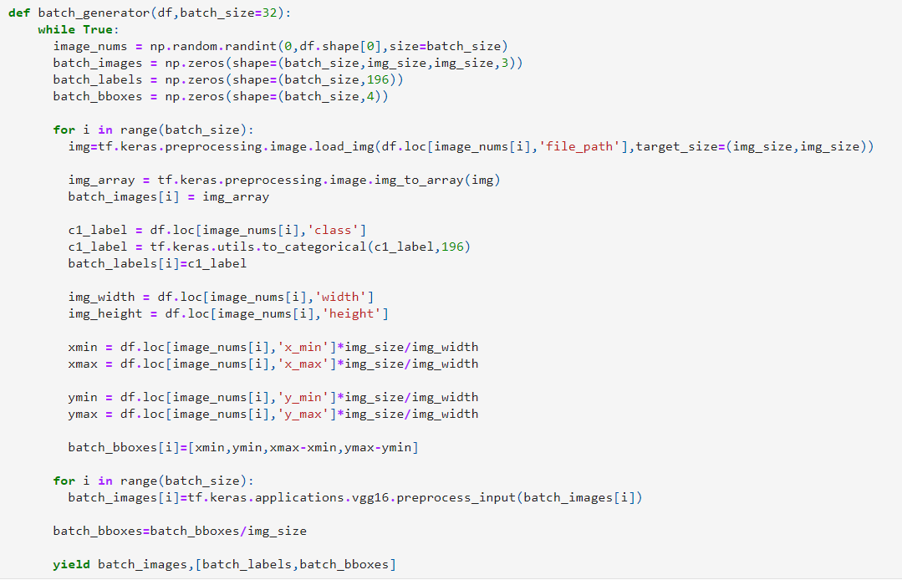
Defining Batch Generator function

Slide 8
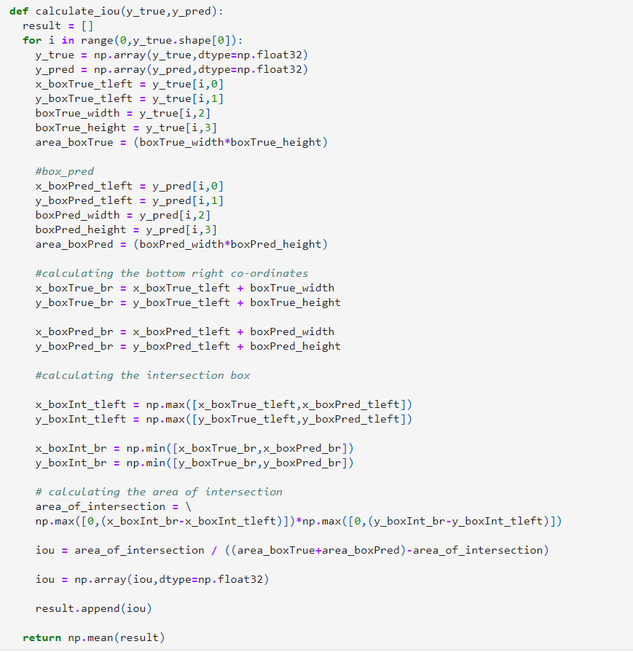
Defining IoU calculation function

Slide 9
Future Plan for Data VGG16 Model Optimization
Training without ‘imagenet’ weight
Image classification using Image Augmentation tool
Separate model building for Classification & Detection
Hyper Parameter Tuning

